Slide 1
Ai-Chatbot
JEEVITHA P
730321104026

Slide 2
AGENDA
Problem statement
Project statement
Project overview
Who are the End users?
Your solution and its value proposition
The wow in your solution
Modeling
Results

Slide 3
PROBLEM STATEMENT
"Develop an AI chatbot to assist users. Requirements: natural language processing, contextual understanding, user engagement, error handling, scalability, and integration with existing systems. Deliver in a user-friendly interface."

Slide 4
PROJECT STATEMENT
Develop an AI chatbot
Utilize natural language processing
Provide assistance, information, and engagement
Enhance user experience
Seamlessly integrate with various platforms
Continuously evolve through machine learning.

Slide 5
PROJECT OVERVIEW
AI chatbot project: Natural language processing, machine learning integration.
Goal: Conversational interface, task automation.
Features: Intent recognition, sentiment analysis, personalized responses.
Technologies: Python, TensorFlow, NLTK, RESTful APIs.
Deliverables: Prototype, documentation, training materials.

Slide 6
WHO ARE THE END USERS?
1. Customers seeking instant support.
2. Website visitors looking for information.
3. Employees needing HR assistance.
4. Patients scheduling appointments.
5. Students accessing educational resources.
6. Gamers seeking in-game guidance.
7. Travelers booking reservations.
8. Consumers browsing product recommendations.

Slide 7
THE WOW IN YOUR SOLUTION
Intuitive user interface
Versatile language comprehension
Responsive real-time interactions
Adaptive learning capabilities
Customizable for various applications
Seamless integration with existing systems
Continuous improvement through user feedback

Slide 8
MODELING
1. Define purpose and scope.
2. Gather and preprocess data.
3. Select model architecture.
4. Train model with appropriate algorithms.
5. Evaluate performance and iterate as needed.
6. Deploy and maintain for continuous improvement.

Slide 9
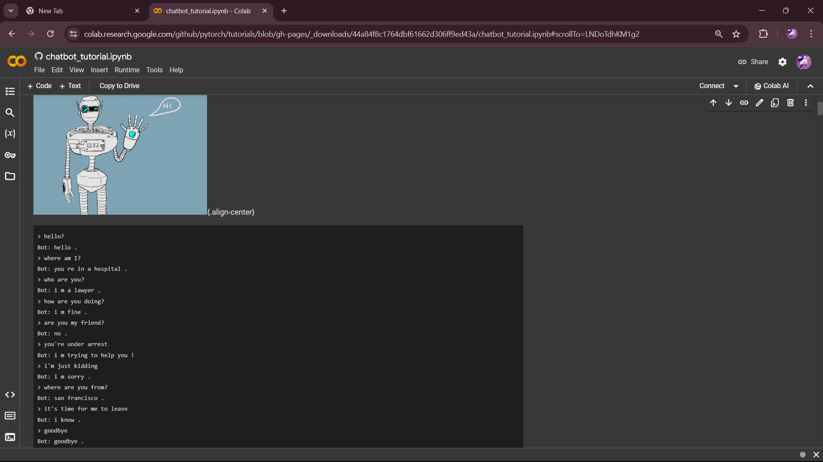
RESULT
AI chatbots provide instant responses, assist with inquiries, streamline processes, and continuously learn to improve interactions and user experiences.

Slide 10
Thank you…

